Slide 1
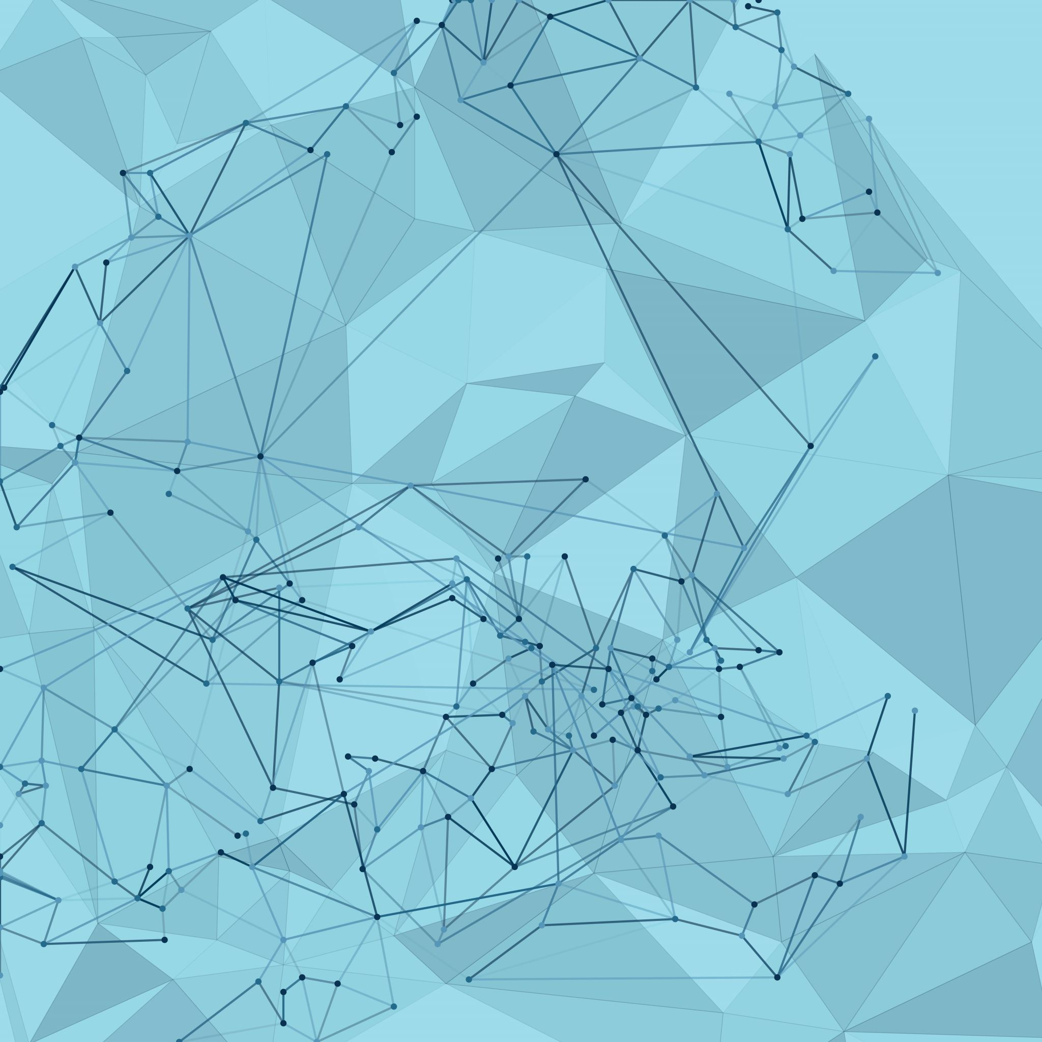

ABM
Absolute Beauty management
By: Daniel Appel: 207386699 Tal Malchi: 208278556 Yuval Ben Simhon: 318916335

Slide 2
Description of the planned system and its need
Goals
The main goal of our application is to create comfortable, accessible and easy-to-use Customer Relationship Management application (CRM) .
Present situation, the need for solution and problem space
At present, there are no Android applications that give such easy-to-use way for managers to interact with, and manage their clients, as well as the revenue and every other day-to-day activities for a small business owner in general and more specifically beauty saloons, the later being the focus of our application.

Slide 3
Description of the planned system and its need
Our application’s advantages
Our application provides a drastically simplistic view on client management, with a client-side implementation for orders and appointment scheduling. This provides the business owner with a unique ability to be able to “learn” to handle a new technology to simplify his/her life in less than a day.
Similar Applications
Bumpix
Bitrix24
Pocket CRM – Customers and Leads

Slide 4
Description of the planned system and its need
Gaps between the original planning
During the work on our project, we realized a few things we would have like to have had the ability to change in our application, but due to time deficiency, such features were not implemented.
Implement a manager’s ability to dynamically change a product’s “profile” picture.
Updating the appointments after deletion of appointments should be made “on the fly”
The design should be more user-friendly and esthetically pleasing.

Slide 5
System Structure
Our application is organized into directories for each main activity, such as Clients, Appointments, Products, Cart, Login and Register, History and Analytics.
We followed the MVC architectural design pattern, which means that each directory contains classes for the view and controller aspects of the activity.
In each directory, we also created a 'Utils' class to handle retrieval and manipulation of data from the server and database, for the corresponding directory (Controllers).
Our server, implemented using Flask, communicates with Firebase to get data regarding certain processes and displays it to the user.

Slide 6
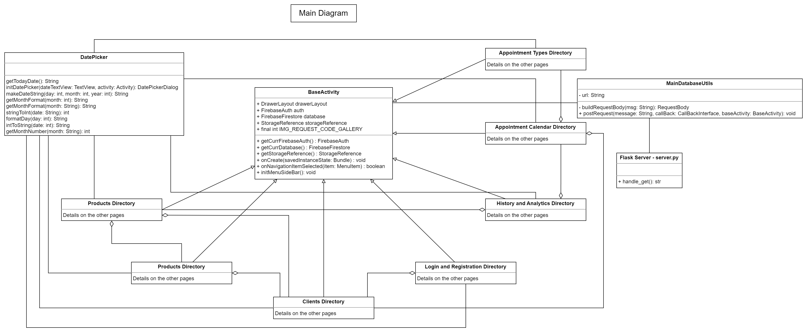
Design Diagram

Slide 7
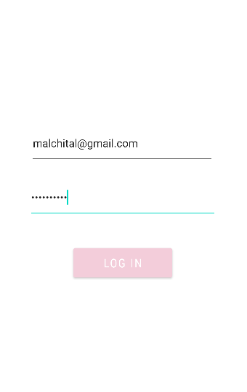
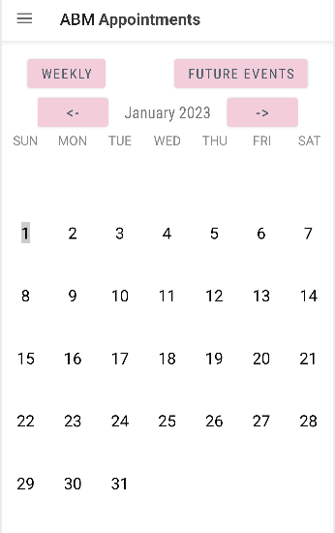
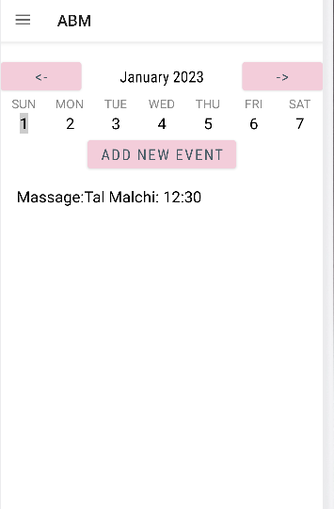
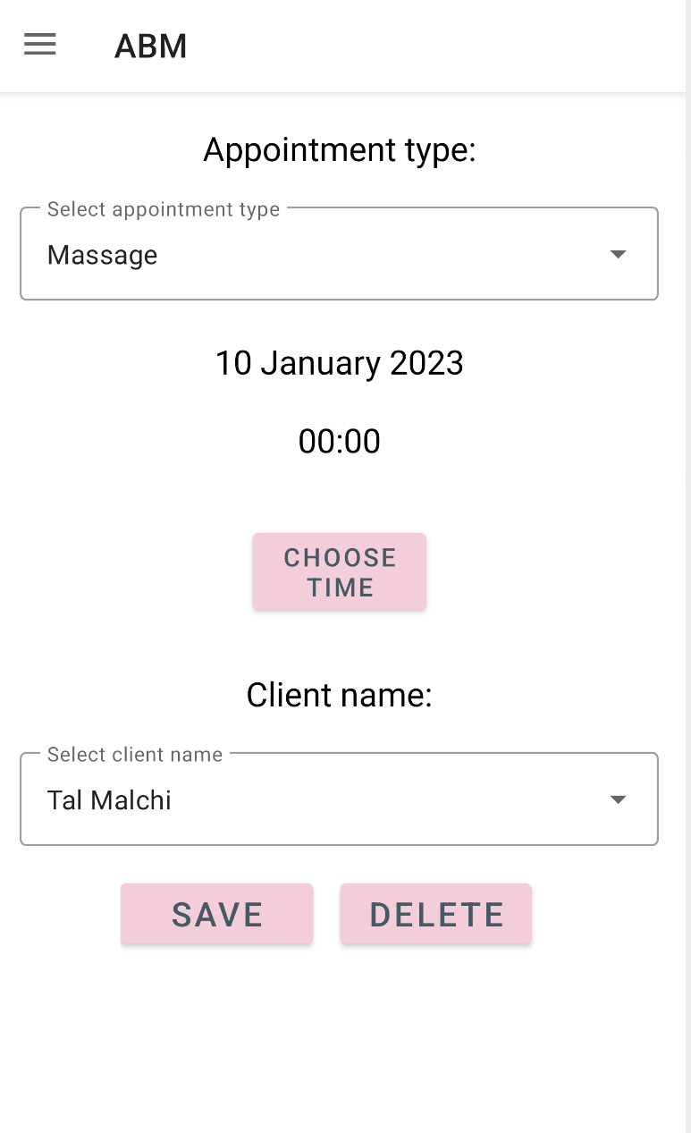
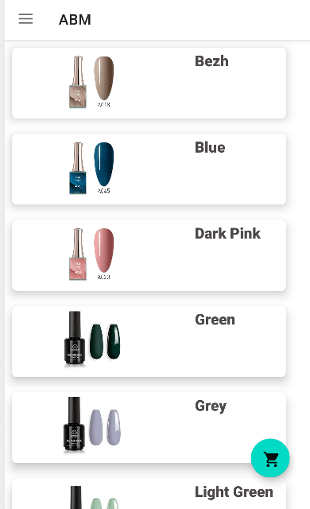
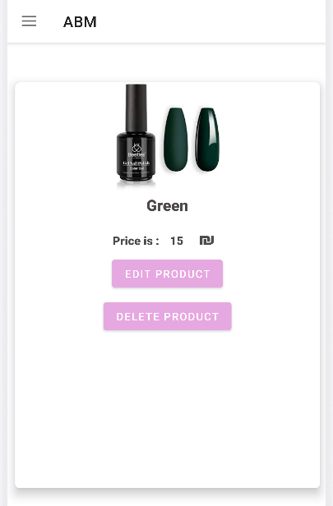
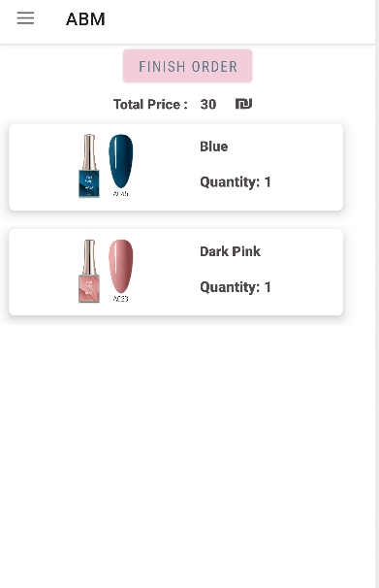
Main capabilities of the application
Login and Registration:
Appointments:
Manager: Adding new, editing, deleting for every client
Client: Adding new, editing, deleting for the current client only
Products:
Manager: Adding new, editing, deleting products from catalogue
Client: Adding new, editing, deleting to and from the cart of the current client (cart unavailable to manager)

Slide 8
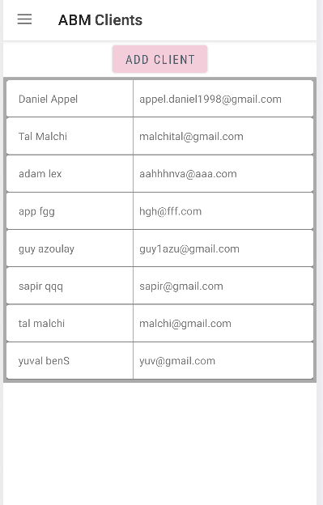
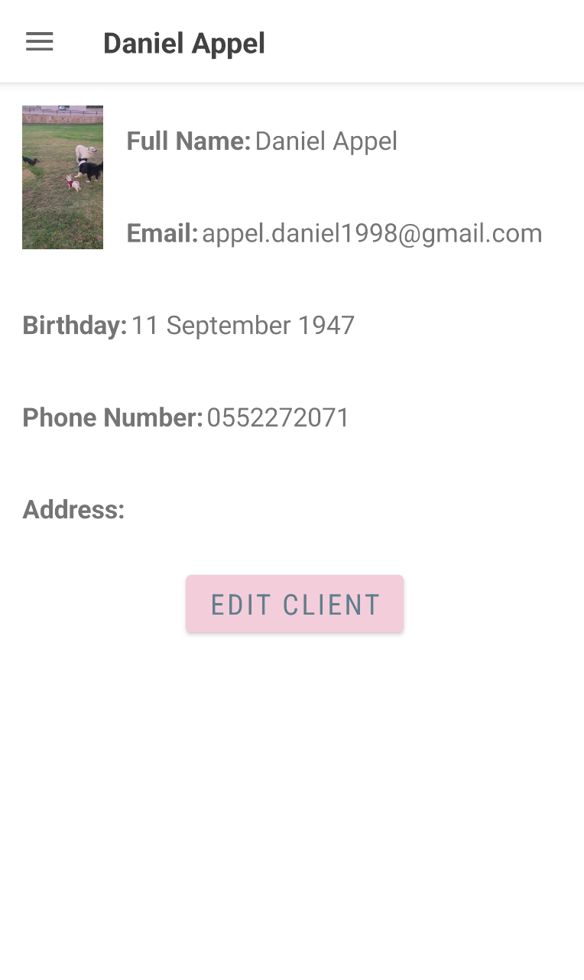
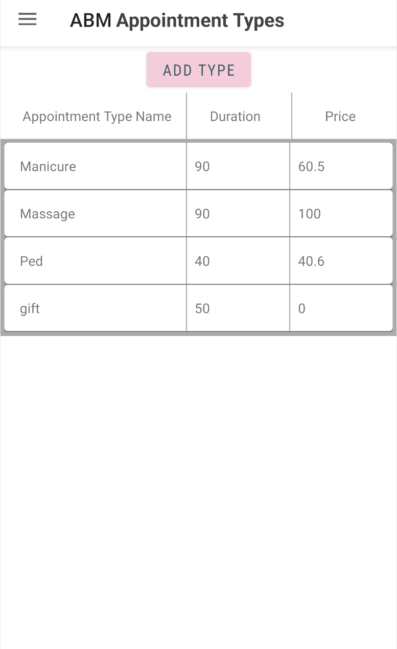
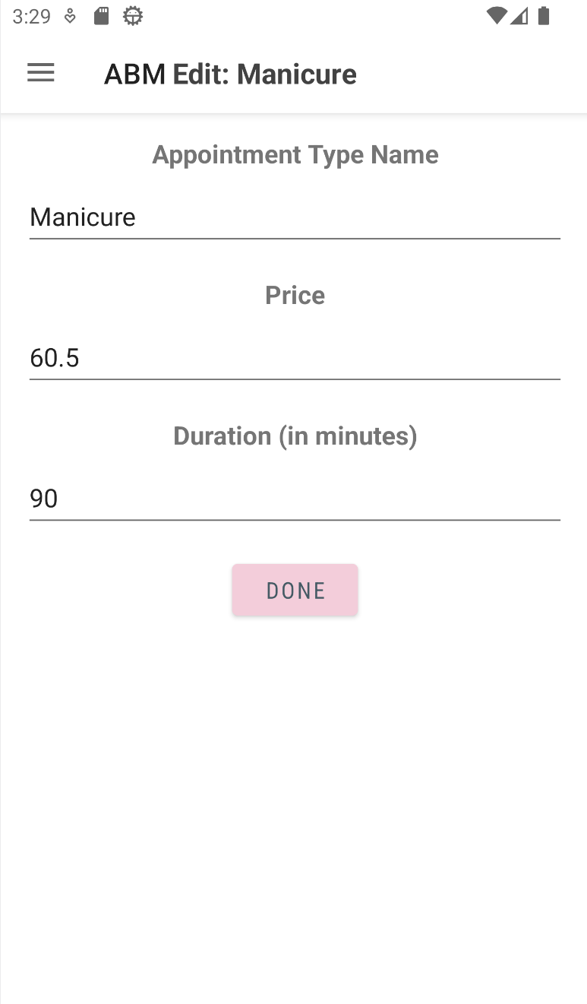
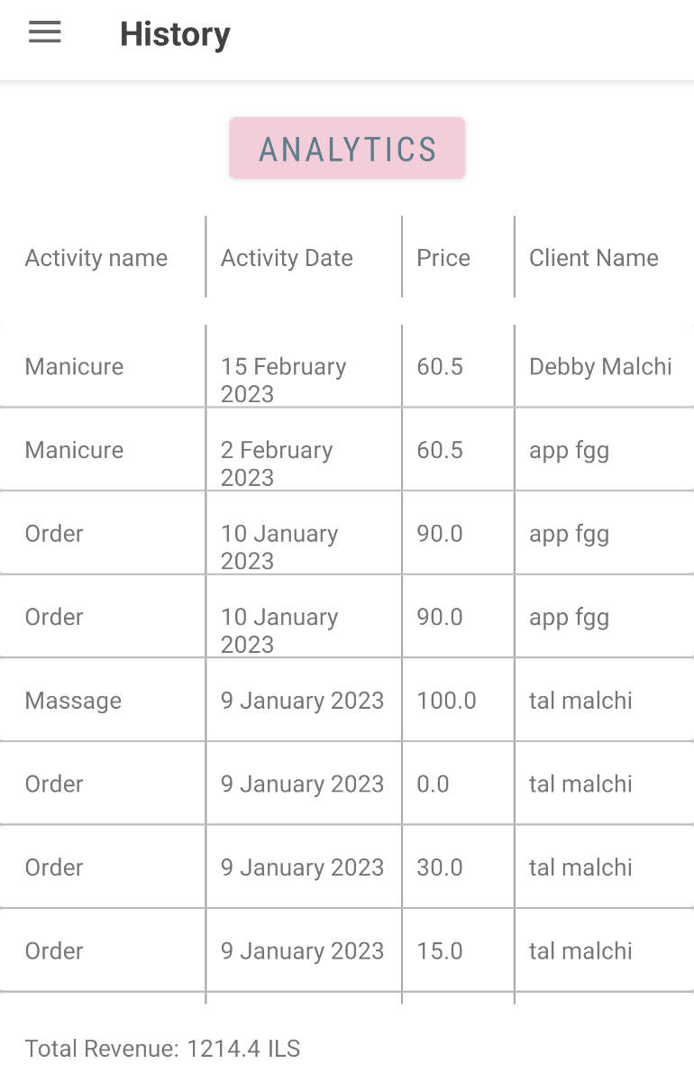
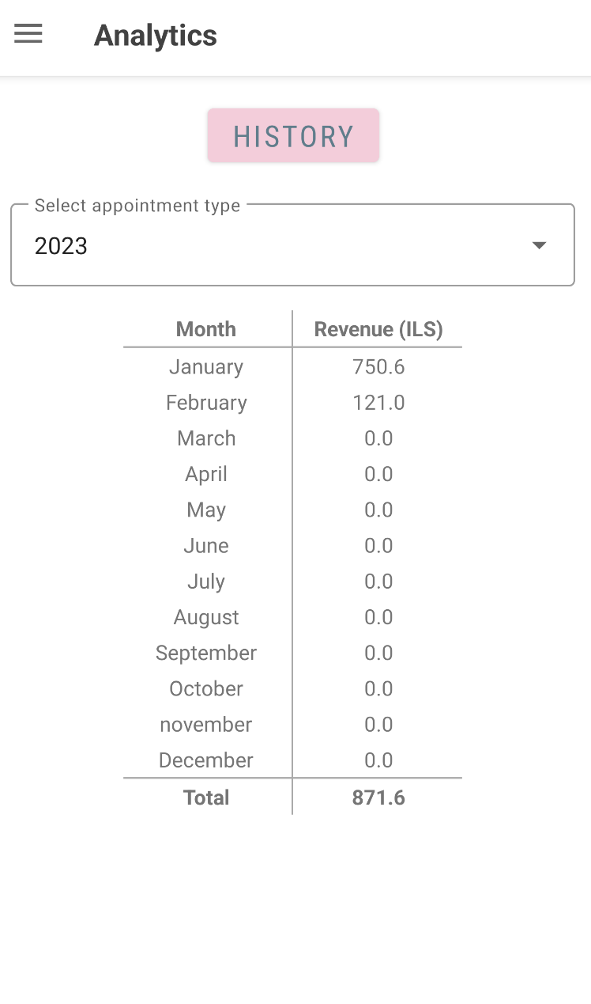
Main capabilities of the application
Clients:
Manager: Adding new, editing, deleting
History and Analytics:
Manager: Viewing history and analytics for all clients
Client: Viewing only history for only the current client
Appointment Types:
Manager: Adding new, editing, deleting appointment types

Slide 9
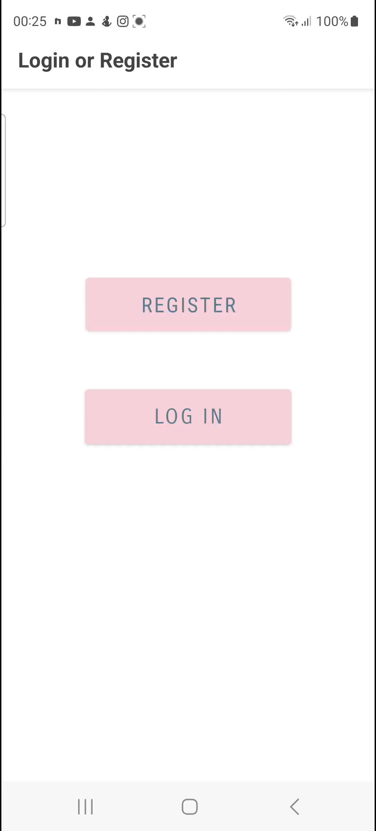
Link to our project on github
Client (Application): https://github.com/appeldaniel1998/ABM
Server (Flask Python): https://github.com/appeldaniel1998/Server-ABM
Thank you for listening!

